Slide 1
Morality Treatment Effect in Debt Repayment
Data Science Academy
Compfest 12
By Team Name

Slide 2
ABOUT THE PROJECT
This final project observed the morality treatment effect in debt repayment, using the data of credit card customers of a large Islamic Bank in Indonesia

Slide 3
Exploring Data
Modelling
Content
01
02
Providing Exploratory Data Analysis (EDA) on the dataset
Predicting credit card default

Slide 4
01
Exploring Data
Providing Exploratory Data Analysis (EDA) on the dataset

Slide 5
QUESTIONS
Debt repayment
Default Customer
Financial
Treatment that affect debt repayment the most
How is the profile of default customer
Can default customer financially pay their debt
01
02
03
04
05
Delinquent
High Risk Customer
Customer that being delinquent more than twice
How is the profile of high risk customer

Slide 6
Steps to Answer
Exploring
01
Preprocessing & Cleansing
02
Analyze & Conclusion
03
Get to know the data and determine what features will we use to answer the question
Make the data more easy to analyze based on what we need
Analyze the data and conclude it based on question

Slide 7
EXPLORING
DATASET
PAPER
MENTORING
Determine what columns will we use based on the question provided
Reading the paper to further understand our dataset
Asking our mentor to further understand what we miss

Slide 8
Cleaning and Preprocessing
Columns
Outliers
Drop
Dataframes
Making new columns based on needs, convert some column
Handling the extraordinary
Dropping data that makes no senses
Makes new dataframes

Slide 9
Debt Repayment

Slide 10
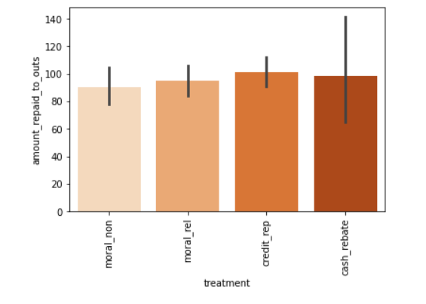
Amount Repaid to Outstanding
Finding how is the ratio between amount that have repaid by customer and the rest of their debt.
Credit reputation and cash rebate have a highest ratio which means the customers comitted to pay off the credit.

Slide 11
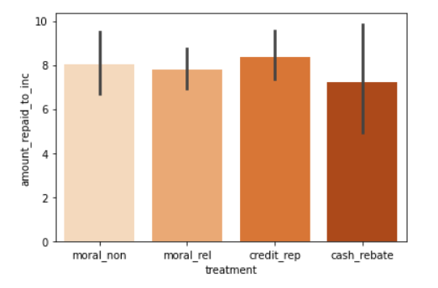
Amount Repaid to Income
Finding how is the ratio between amount that have repaid by customer and their income.
Credit reputation and non-religious moral incentives have a highest ratio which means the customers comitted to pay their credit regardless the amount of income they get monthly.

Slide 12
Conclusion
There are two result of the most affecting treatment to increase debt repayment rate based on the calculation before:
Ratio of amount income per outstanding result credit reputation and cash rebate.
Ratio amount repaid per income result credit reputation and non-religious moral incentive.

Slide 13
2. Delinquent

Slide 14
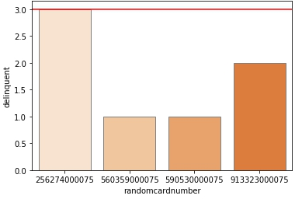
Random Card Number
Finding duplicate random card number and see how many times that card detected as delinquent.

Slide 15
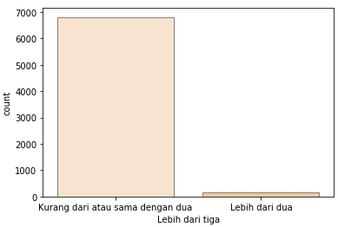
Treatment Waves
We assume when customer detected as delinquent they will get treatment.

Slide 16
Conclusion
We got two results from previous analysis:
Random Card Number : 1
Treatment Wave: 167
Then we take result from second analysis because it makes more senses

Slide 17
3. Default Customer

Slide 18
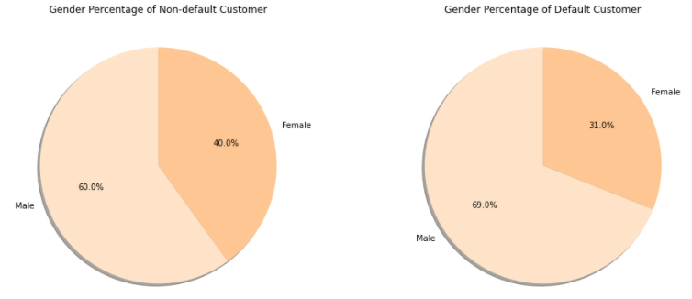
Gender
Men tend to be default than women

Slide 19
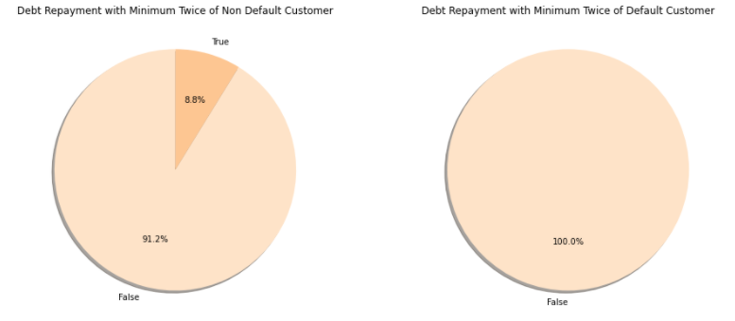
Debt Repayment
Default customers never pay more than once

Slide 20
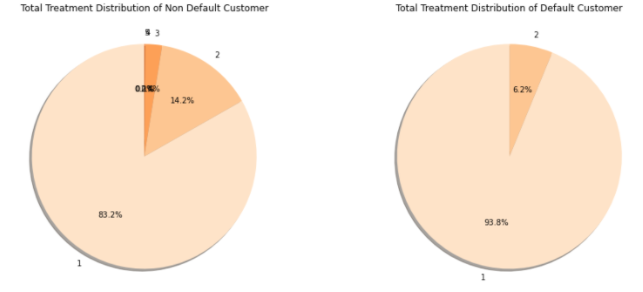
Total Treatment
Default customers get 1-2 treatment with mainly just one.

Slide 21
4. High Risk Customer

Slide 22
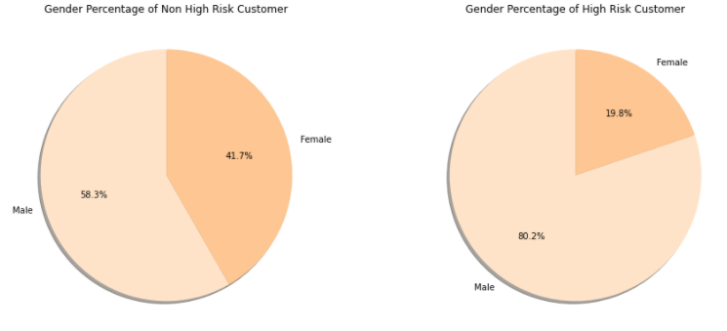
Gender
Men have a high risk more than women

Slide 23
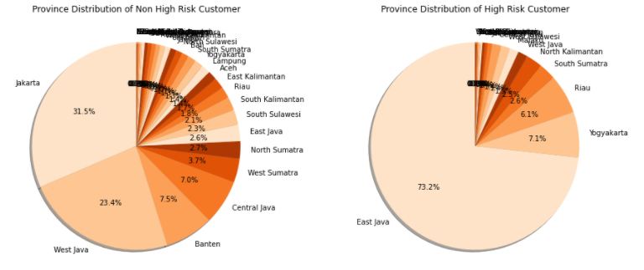
Province
High risk customer dominantly live in East java

Slide 24
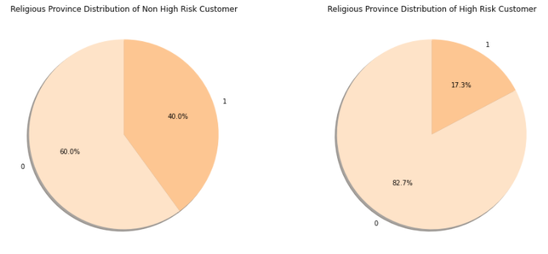
Religious Province
Customer from non-religious province tend to have a high risk in credit

Slide 25
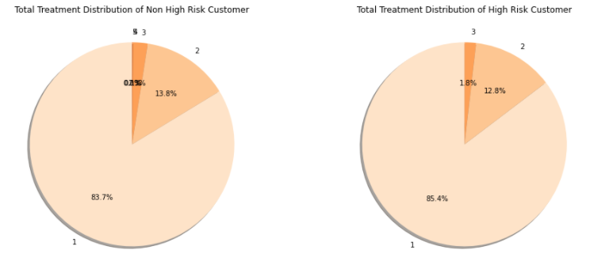
Total Treatment
High risk customers get 1-3 treatments with mainly just one.

Slide 26
5. Financial

Slide 27
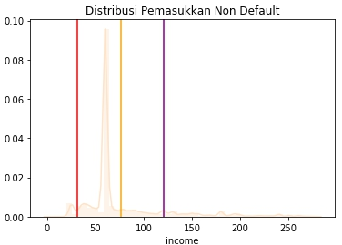
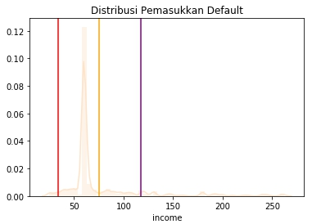
Income
We look into default customer income and compare it with non default customer.

Slide 28
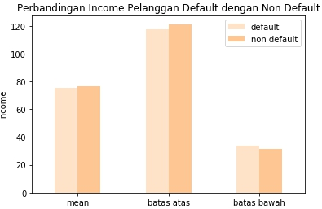
Income
Look more closely

Slide 29
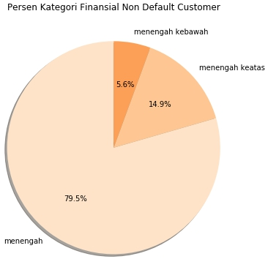
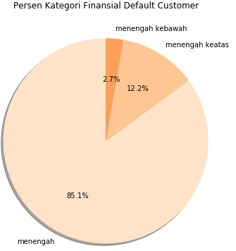
Income
And classify it

Slide 30
Conclusion
Customer that identifies as default is financially as able as customers that not default.

Slide 31
02
MODELLING
Predicting credit card default

Slide 32
Supervised Learning: Classification
EXPLORING
TRAINING
Surfing on the dataset to get to know them
Using machine learning to train the model
01
02
03
04
CLEANING & PREPROCESSING
EVALUATION
Cleaning the raw dataset preparing to be trained
Get the evaluation of model

Slide 33
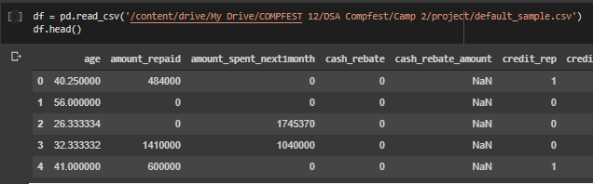
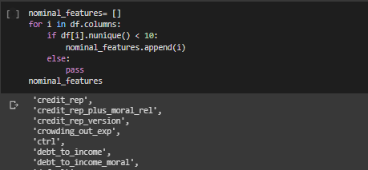
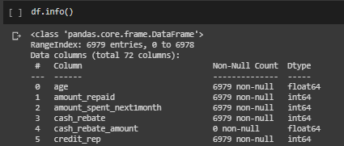
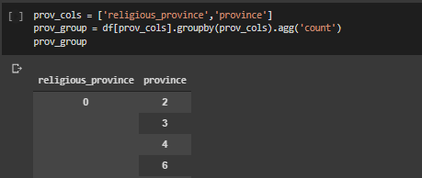
Exploring
The First Insight to Understand The Underlying
Mercury is the closest planet to the Sun
Venus has a beautiful name, but it’s terribly hot
Despite being red, Mars is actually a cold place
Saturn is composed mostly of hydrogen and helium

Slide 34
Cleaning and Preprocessing
Dropping
Outliers
Encoding
Imbalanced Label
NaN Filling
Deleting the unused and doubled
Handling the extraordinary
Getting the categorical to be numericalized
Equalize the data based on the target
Filling the NaN on the data

Slide 35
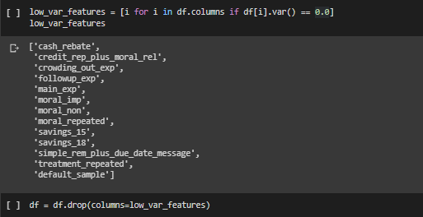
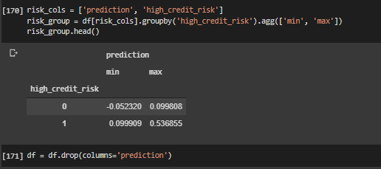
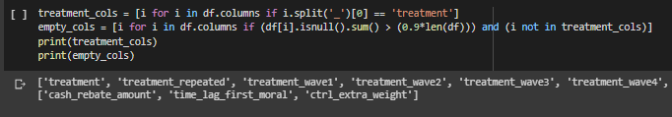
Dropping
Relatively Empty
Determining the columns that have more than 90% empty or null
Doubled
Very Low Variance
Finding the features that can be represented by others, e.g. low_credit_risk can be represented by high_credit_risk
Calculating the variance and dropping the very low, e.g. dropping columns with 0 variance such as treatment_repeated

Slide 36
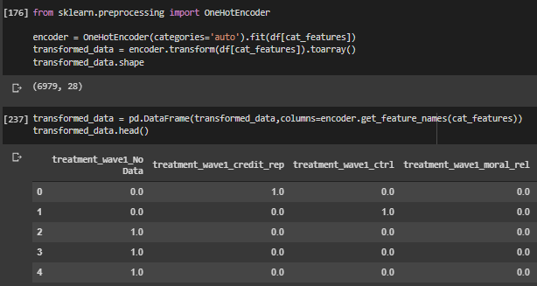
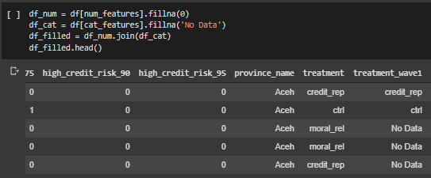
NaN Filling
Encoding
For non-empty columns relatively, the NaNs or nulls are filled, 0 integer for numerical, and a string for categorical.
For categorical features, they have to be numericalized, such as using one-hot encoder

Slide 37
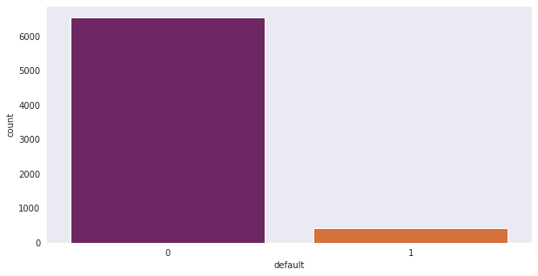
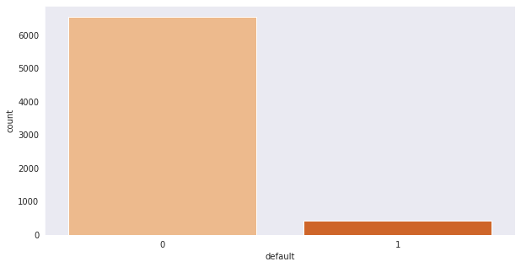
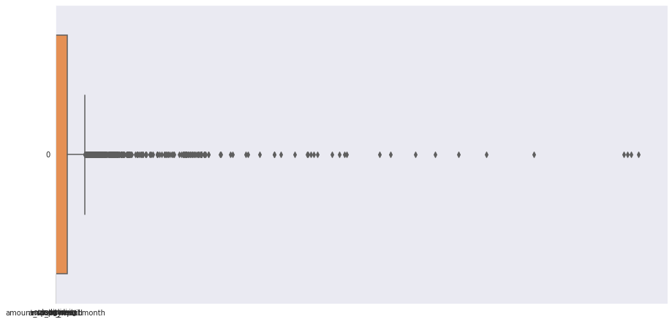
Outliers
Imbalanced Label
Using the formula of 2 times the Interquartile Range, the outliers are replaced by the upper or lower non-outlier range, then checked by its skewness value.
Based on the target, that is default columns, the data are been oversampling using SMOTE after splitted as train and test data

Slide 38
Training and Evaluation
Classification Models Used for Comparison
Decision Tree
Gradient Boosting
Random Forest
XGradient Boosting
Logistic Regression

Slide 39
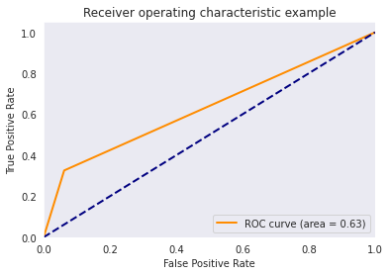
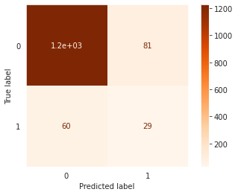
Decision Tree
ROC and AUC
Confusion Matrix
AUC = 0.63

Slide 40
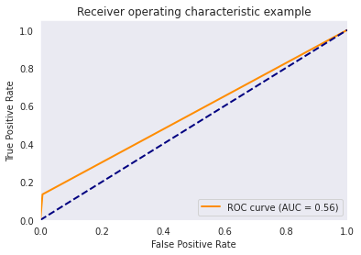

Random Forest
ROC and AUC
Confusion Matrix
AUC = 0.56

Slide 41

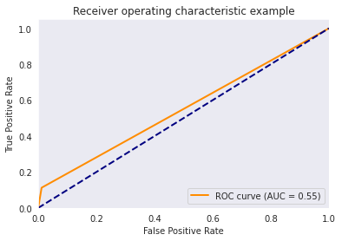
Gradient Boosting
ROC and AUC
Confusion Matrix
AUC = 0.55

Slide 42
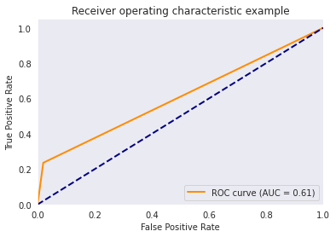

XGradient Boosting
ROC and AUC
Confusion Matrix
AUC = 0.61

Slide 43
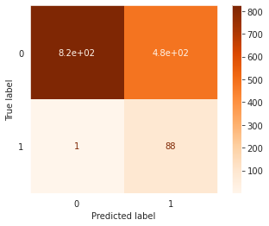
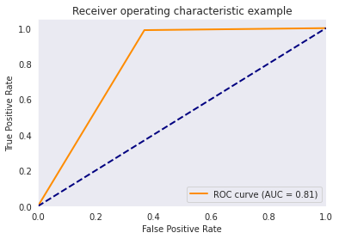
Logistic Regression
ROC and AUC
Confusion Matrix
AUC = 0.81

Slide 44
Evaluation Rank by AUC Score
Logistic Regression
0.81
Decision Tree
0.63
XGradient Boosting
0.61
Random Forest
0.56
Gradient Boosting
0.55

Slide 45
Conclusion
Relatively compared to another models, Logistic Regression performed better in classification for this case of determining default customer, although we have not maximized the AUC score to get the better one.

Slide 46
THANKS
—Team Name

